Slide 1

Travel Booking Database Project
Presented by Zhenjun Huang and Xin Huang
COMP 520 Advanced Database Systems

Slide 2

Project Overview
Track Preferences
Predict Costs
Optimize Options
Capture and analyze customer travel choices and feedback.
Estimate total trip expenses in real time.
Recommend the best travel packages within budget.
Goal
Deliver personalized, affordable trip plans based on customer preferences.

Slide 3





Problem to Solve
Trip Duration
Affordable Stays
Easily filter and select travel packages by desired trip length.
Find and recommend budget-friendly hotels and accommodations.
1
2
Comprehensive Cost Estimation
Best Plan
Suggest the most suitable and personalized travel plans for each customer.
4
3
Provide accurate, all-inclusive trip cost estimates (covering hotels, flights, and insurance).

Slide 4

Data Sources
AI-generated datasets simulate flights, hotels, customers, and ratings.

Slide 5
Business rules
Each customer must have a unique email.
No duplicate bookings per customer.
Departure city must match previous arrival city.
Bookings must link to existing Trip records.
Rating and comment only after completed the trip
Complaint Flag

Slide 6




Technologies
Frontend
React, Axios, Bootstrap
Backend
Node.js, Express(RESTful API)
Database
MySQL (with MySQL Workbench for management)

Slide 7
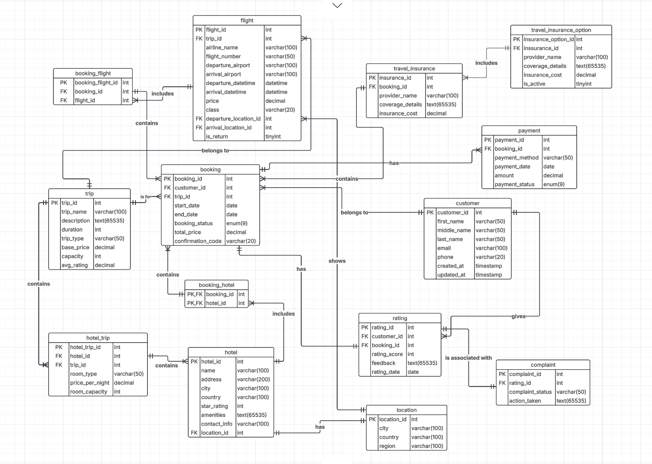
ERD

Slide 8
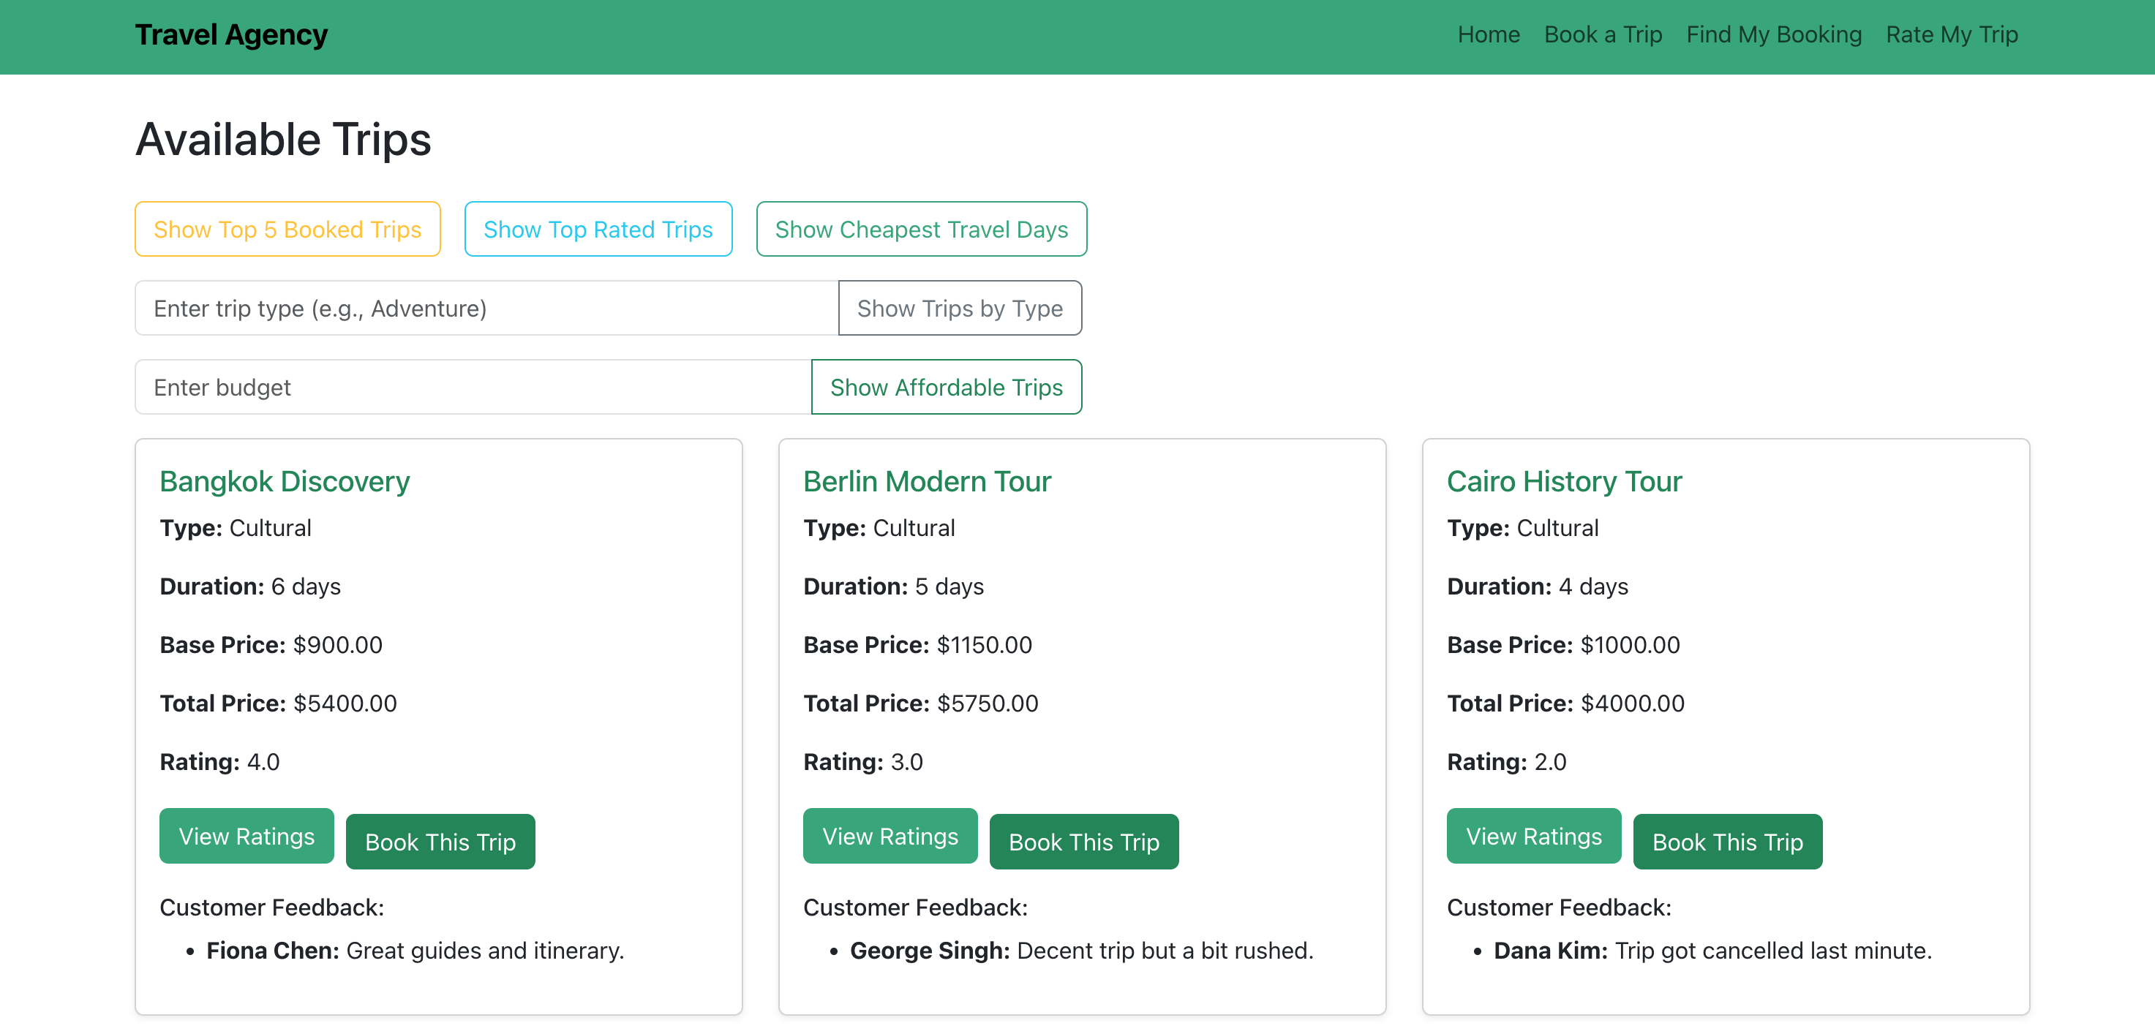
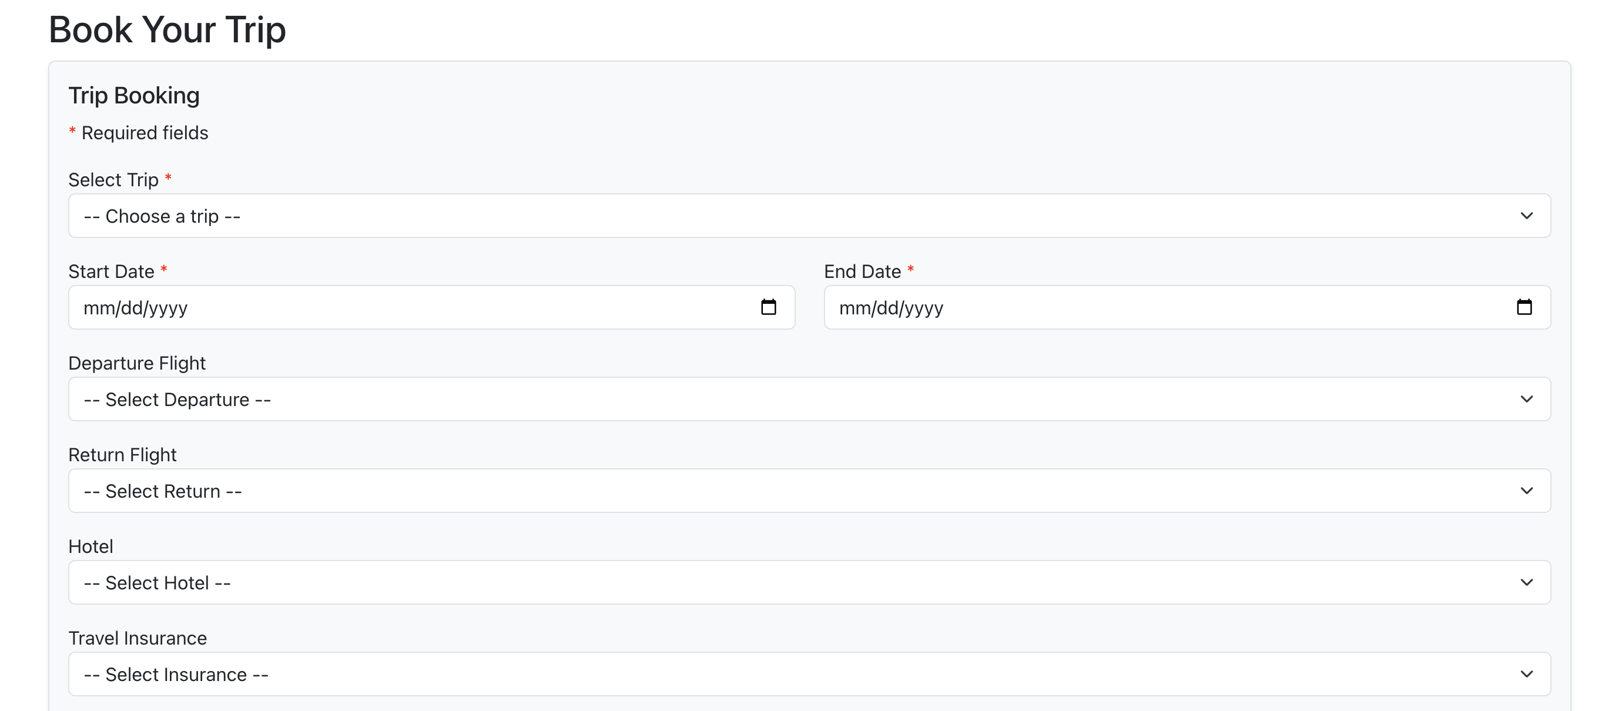
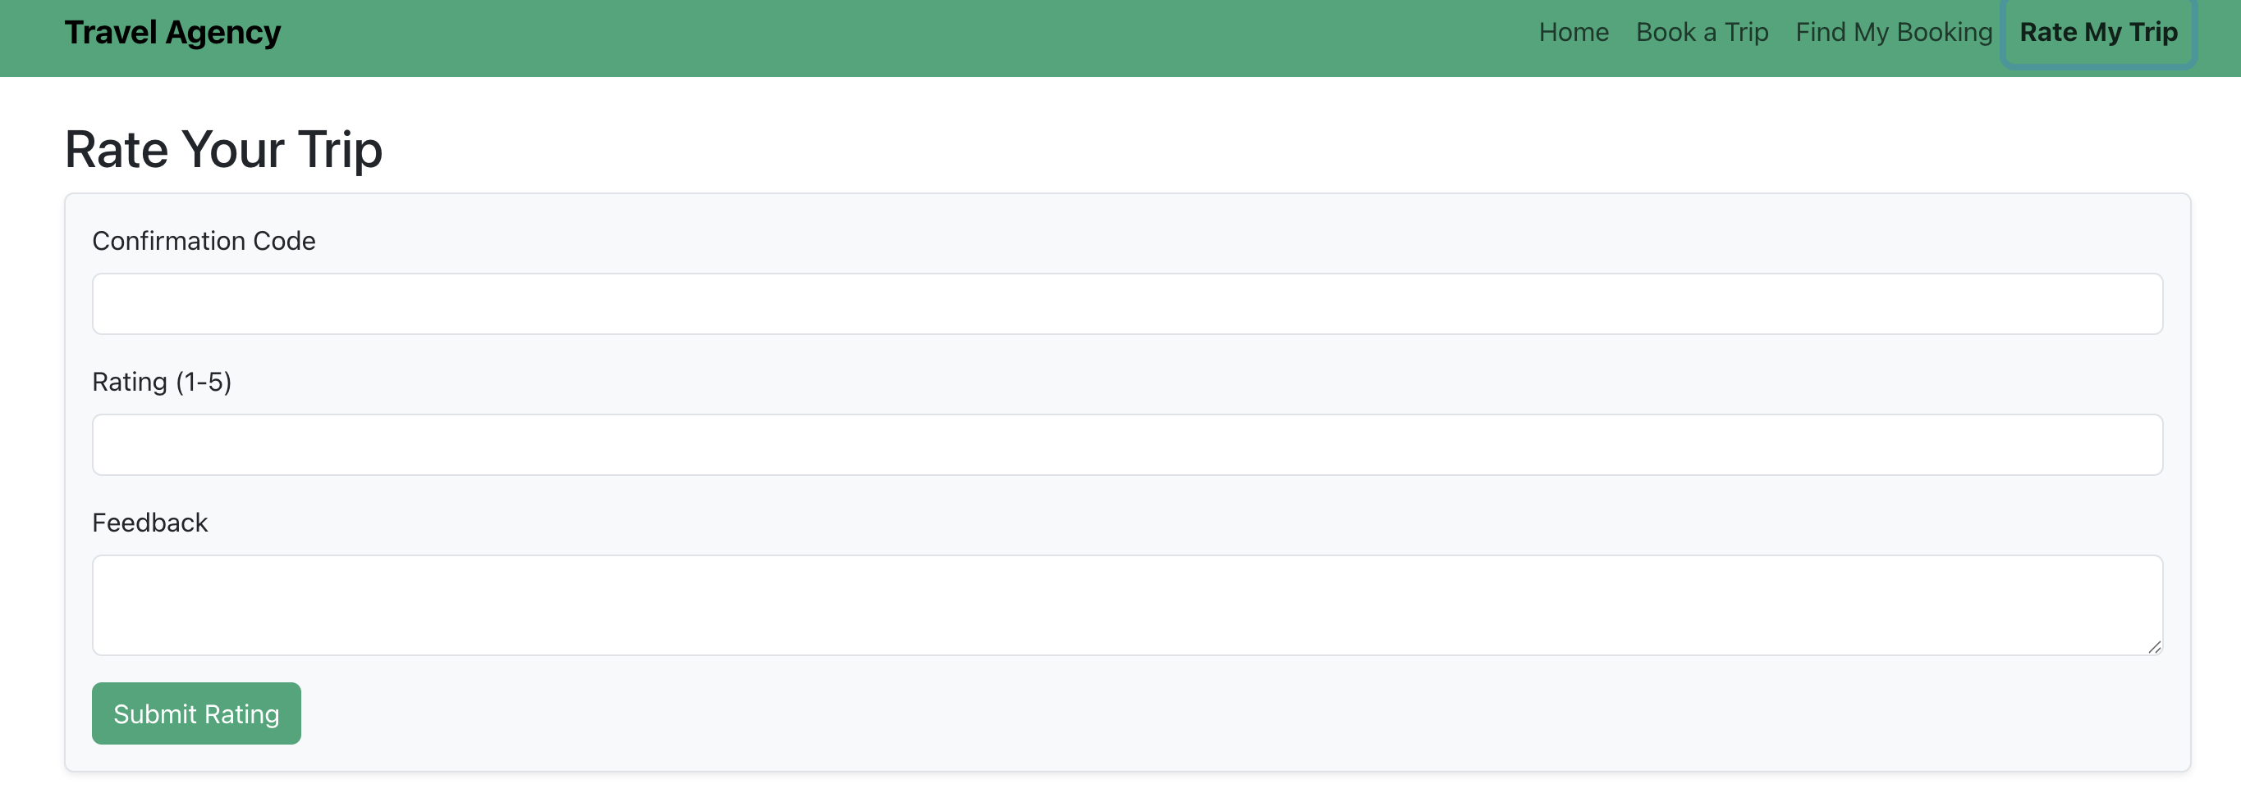
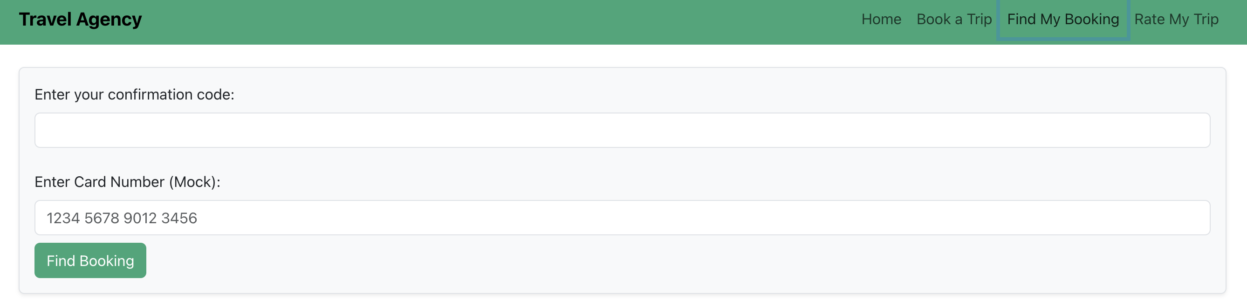
User Interface
Trip search and filtering
View trips details
Booking a trip
Rate trips and give feedback
Booking history and status tracking

Slide 9
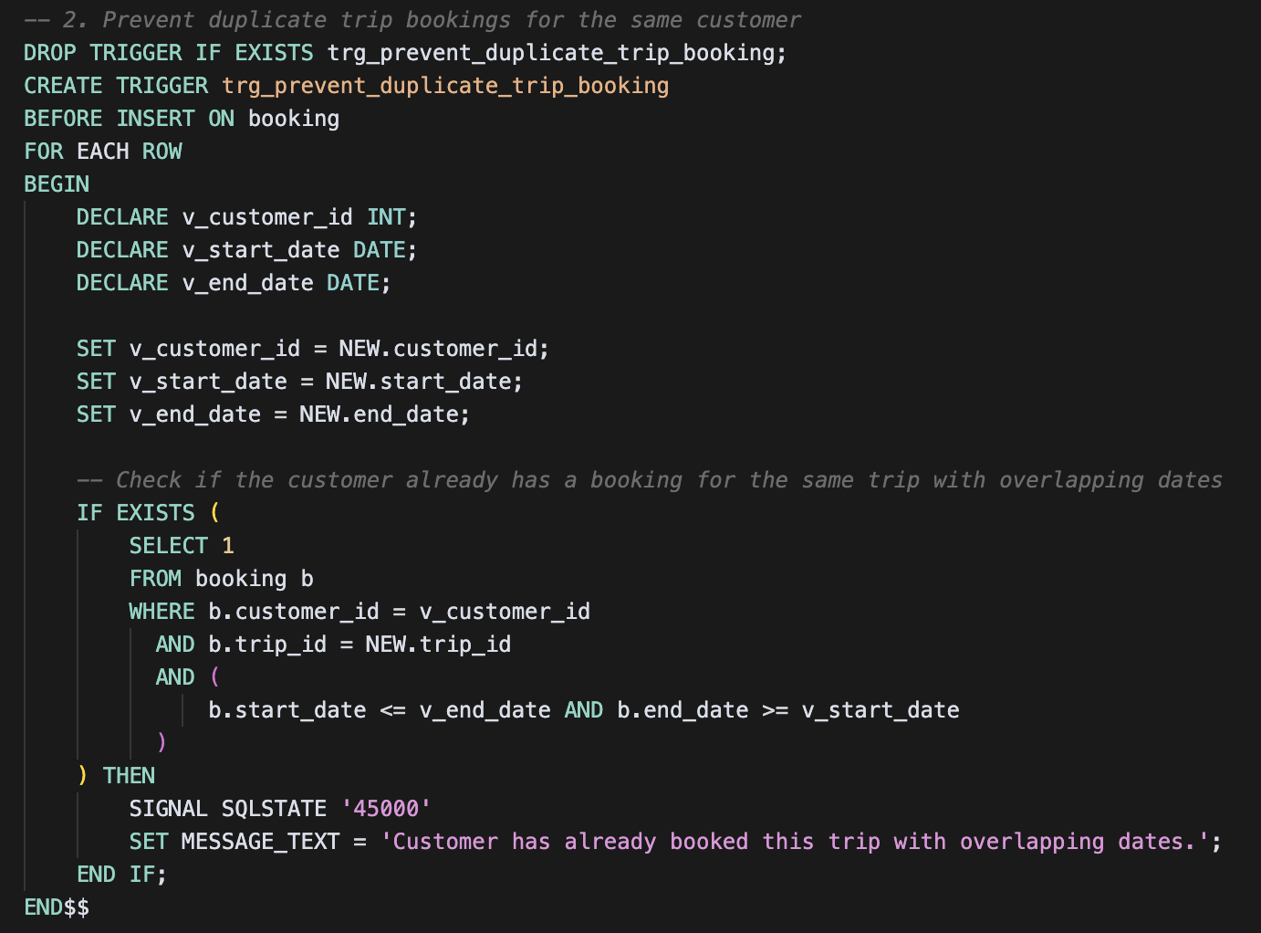
Views
Shows all available trips for booking
Shows booking details by confirmation code
List all available flights per trip
List all available hotels per trip
Display available travel insurance for each booking

Slide 10
Triggers
Prevent duplicate bookings for the same customer
Automatically flag a complaint for a rating below 3
Updates the average rating for a trip whenever a new rating is added.

Slide 11
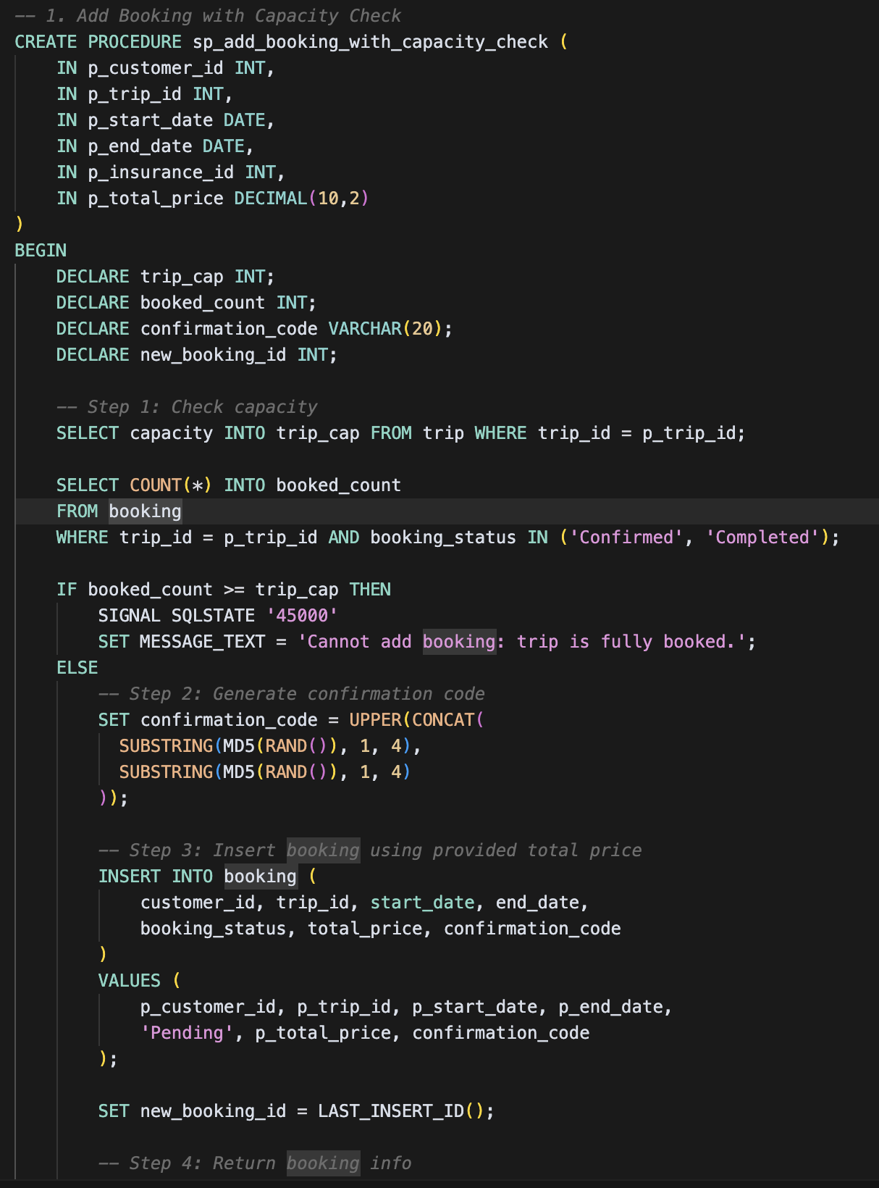
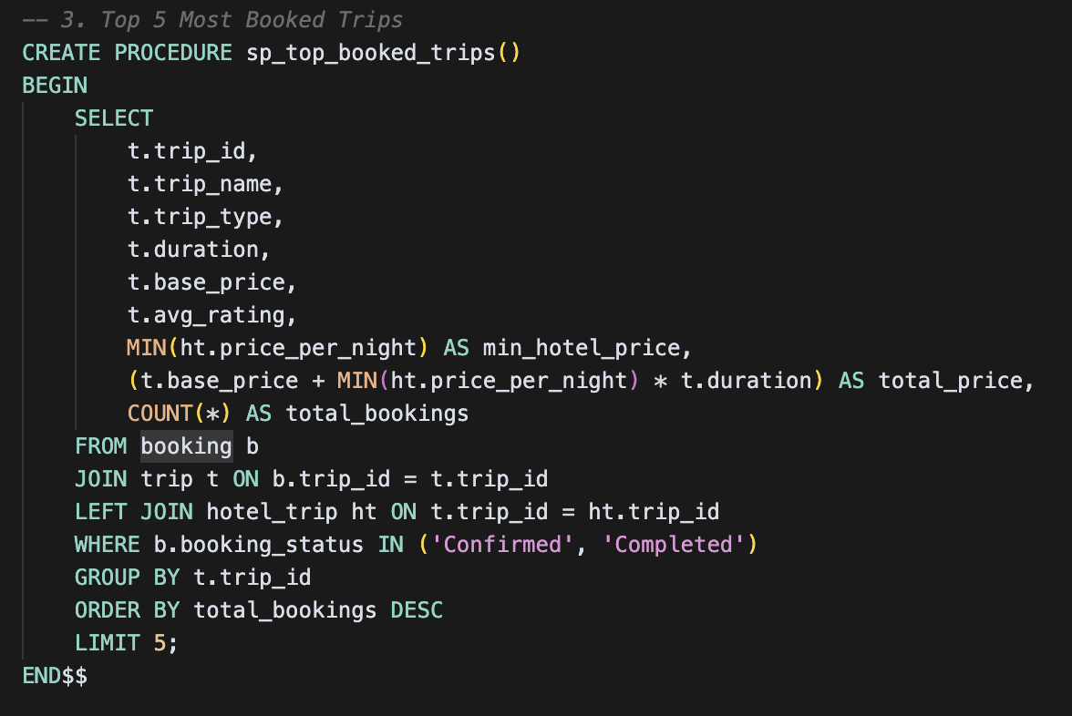
Stored Procedures
Make or Manage Bookings
Find Popular and Affordable Trips
Submit and View Trip Reviews
Track Customer Spending
Browse Trips with Prices and Ratings

Slide 12
GUI Demo

Slide 13


